Slide 1

Data Analytics Bootcamp
Project 1 | Group 4
2021
Notes:
BG
Opening slide

Slide 2
Meet the Team
Alysha Snowden
Alvin Lucero
Bec Gould
Ernest Bondi
Notes:
BG
Introduce Team Members

Slide 3
Contents
Introduction
Hypothesis & Questions
Data Clean-up & Exploration
Data Analysis
Discussion
Post Mortem
Data Sources
Notes:
BG
Provide overview of presentation slides to give audience a high level overview
Just some housekeeping – please post questions in the chat and we will answer them in our Q&A.

Slide 4

World Happiness
Report
2015 - 2019
Notes:
BG
Introduce the topic

Slide 5
Introduction:
As a global society, we are waking up to the fact that happiness in our daily lives is extremely important. The positive effects of a balanced mind spread not only throughout a person's life, but also throughout society in a stone-in-the-pond figure of speech.
The World Happiness Report is a publication of the Sustainable Development Solutions Network, powered by data from the Gallup World Poll and Lloyd’s Register Foundation, who provided access to the World Risk Poll.
The purpose of this project is to dive in and analyse the happiness score per country around the world and the main characteristics of what forms “Happiness”.
Notes:
BG
Write overview of “happiness” and brief summary of the world happiness report
Detail Data sources used
Elaborate on the questions you asked, describing what kinds of data you needed to answer them, and where you found it
https://www.kaggle.com/mathurinache/world-happiness-report

Slide 6

Questions:
Hypothesis:
Where are the ten Happiest Countries in the world?
H0:Happiness has no relationship with Economy (GDP per capita)
Why are they the Happiest Countries?
How does Australia compare to other countries?
Notes:
BG

Slide 7







Data Sources & Libraries:
https://www.kaggle.com/mathurinache/world-happiness-report
https://geopandas.org/docs/user_guide/mapping.html
Notes:
AL
Elaborate on the questions you asked, describing what kinds of data you needed to answer them, and where you found it

Slide 8

Notes:
AL
Describe the exploration and clean-up process
Discuss insights you had while exploring the data you didn’t anticipate
Discuss any problems that arose after exploring the data, and how you resolved them
Present the discuss interesting figures developed during exploration, ideally with the help of Jupyter Notebook
Notes:
Using a jupyter notebook

Slide 9

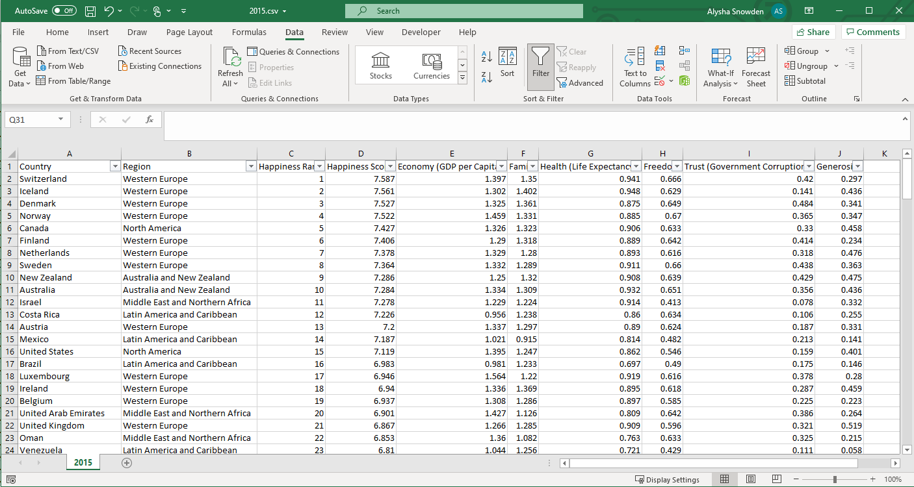
Data Clean-up & Exploration:
Populated the missing region values per CSV data source file using excel VLOOKUP function.
Notes:
AL
Describe the exploration and clean-up process
Discuss insights you had while exploring the data you didn’t anticipate
Discuss any problems that arose after exploring the data, and how you resolved them
Present the discuss interesting figures developed during exploration, ideally with the help of Jupyter Notebook
Notes:
Upon reviewing the CSV file data frames, we identified that that some the CSV files were missing regions. We used VLOOKUP in the csv file to add in the missing region values.

Slide 10


Data Clean-up & Exploration:
Using Jupyter notebook we first imported the data sources and read the csv files.
Notes:
AL
Describe the exploration and clean-up process
Discuss insights you had while exploring the data you didn’t anticipate
Discuss any problems that arose after exploring the data, and how you resolved them
Present the discuss interesting figures developed during exploration, ideally with the help of Jupyter Notebook
Notes:
Using Jupyter notebook we first imported the data sources and read the csv files.

Slide 11
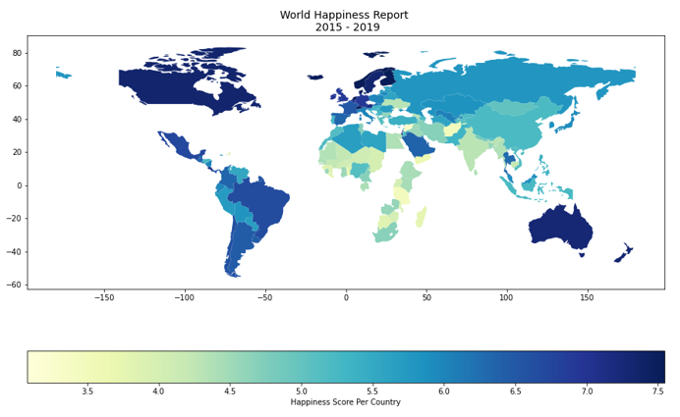
World Map:
Notes:
AS
Geopandas Choropleth Map
To provide an overview of the happiness score per country around the world we are using a geopandas choropleth map to provide a visual.
Geopandas provides a high-level interface to the matplotlib library for making maps and takes pandas's DataFrame to the next level by allowing it to parse geospatial data.
Install required Python libraries
Load and view the shapefile data
Inspect count of the World shape file data
merge both data sets using name/Country as unique identifiers
check the occurrence
plot merged file

Slide 12
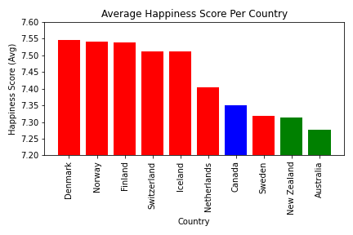
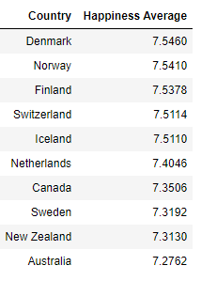
Where are the top 10 happiest countries?
Notes:
AS
From a reset data frame, we have generated a Pyplot bar graph which reflects the highest 10 Happiest Countries in the world based on an Average Happiness Score Per Country.
From the bar graph we can see the top ten happiest Countries are Denmark, Norway, Finland, Switzerland, Iceland, Netherlands, Canada, Sweden, New Zealand and Australia.

Slide 13
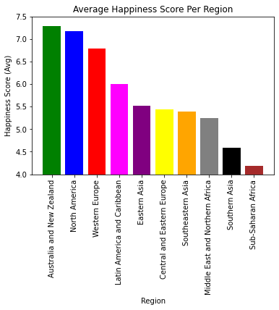
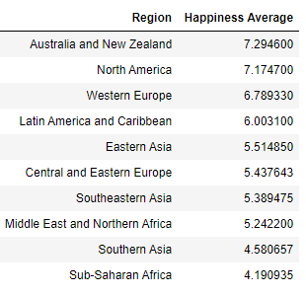
Which region has the highest happiness score?
Notes:
EB

Slide 14
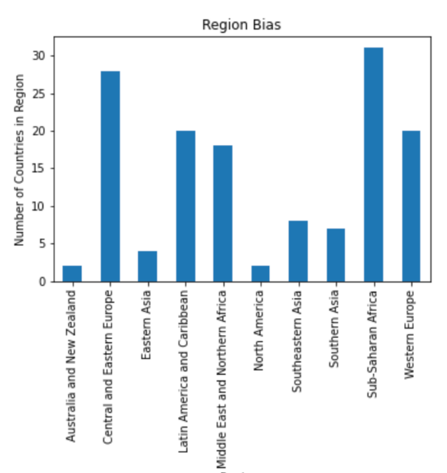
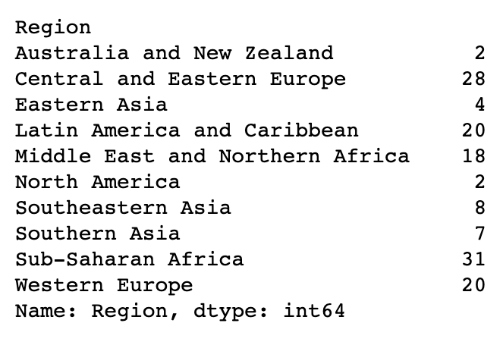
Breakdown of regions
Notes:
EB

Slide 15
What are the variables that are used to measure happiness?
Health (Life Expectancy)
Generosity
Trust (Government Corruption)
Family/Social Support
Freedom
Economy (GDP per Capita)
Notes:
AS
So, what are the variables that are used to measure happiness?
The World Happiness report and the annual release of the Gallup World Poll (GWP) indicates the following variables are used to measure the national average response to the question of life evaluations.
Characteristics:
Trust (Government Corruption) - The measure is the national average of the survey responses to two questions in the GWP: “Is corruption widespread throughout the government or not” and “Is corruption widespread within businesses or not?”
Generosity – Residual of regressing the national average of responses to the question “Have you donated money to a charity in the past months?”
Health (Life Expectancy) – Average number of years that a newborn can expect to live in full health.
Family – Having friends and other people, including family, turning to in times of need or crisis to give you a broader focus and positive self-image.
Freedom – Freedom of choice describes an individual's opportunity and autonomy to perform an action selected from at lease two available options unconstrained by external parties.
Economy (GDP per Capita) – Measure of a country's economic output that accounts for its number of people.

Slide 16
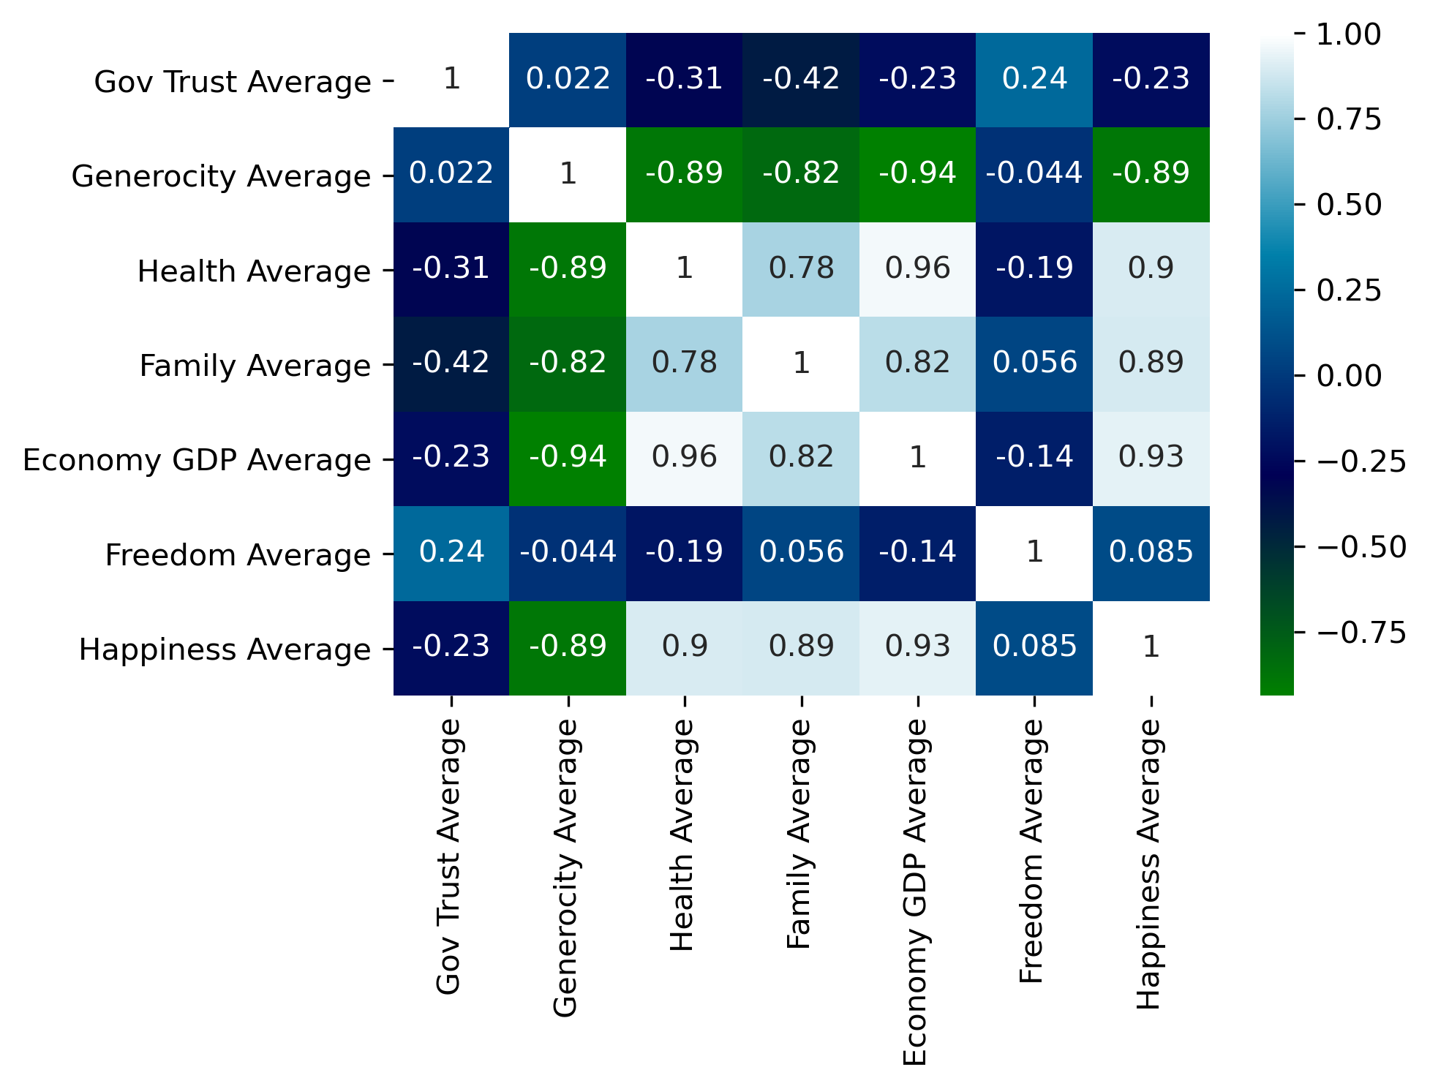
Why are they the happiest countries?
Top variables contributing to happiness
Economy GDP
Health
Family
Notes:
AS
Seaborn Correlation Heatmap
When generating a correlation heatmap using the seaborn library you can easily see the top three variables contributing to happiness are;
Economy GDP
Health
Family

Slide 17
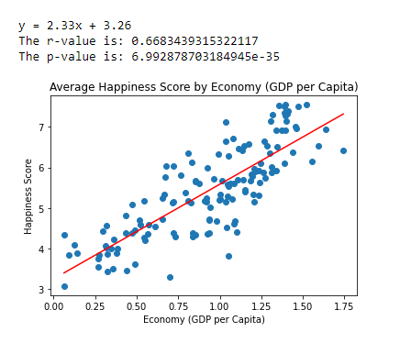
Does Economy (GDP Per Capita) correlate with happiness score?
Notes:
EB

Slide 18

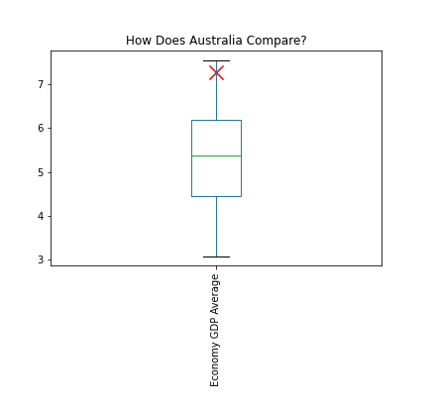
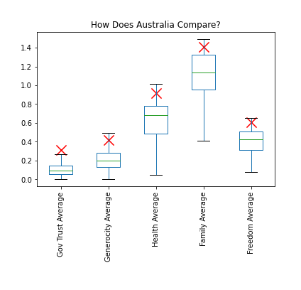
How does Australia Compare to other Countries?
Australia is above 75% countries for each variable score
We have a very high Government Trust score → our data point is considered an outlier when compared to other countries
Notes:
AL

Slide 19
Discussion
In the Top 10 Countries by Happiness Score, 7/10 are from the Western Europe Region
However, Western Europe ranks third in region happiness score
Australia and New Zealand region ranks as the happiest region
Economy, health and family have the highest correlation with happiness score
Australia being ranked 10th is indicative of our variable scores being higher than 75% of countries
Notes:
AL
Discuss your findings. Did you find what you expected to Find? If not, why not? What interferences or general conclusions can you draw from your analysis.

Slide 20
Hypothesis Conclusion
H0: Happiness has no relationship with Economy (GDP per Capita)
Analysis shows p-value = 6.992878703186441e-35
P-Value < 5%
We reject null hypothesis and accept alternate hypothesis
H1: Happiness does have a relationship with Economy (GDP per Capita)
Possible Outcomes:
Government policies can be catered around ensuring good economic output, providing social support for people and investing in health sectors in order to keep a country happy
Notes:
AL
Discuss your findings. Did you find what you expected to Find? If not, why not? What interferences or general conclusions can you draw from your analysis.

Slide 21
Post Mortem
We originally planned on doing our project on Covid and how it affected the suicide rate, the divorce rate and was there an increase in births. We had issues with trying to find the data and also current data.
We identified a problem with the data when completing the correlation heat map. Our code was calling the incorrect data frame and was resulting in the incorrect figures being generated.
We identified a bias in the data as some regions have multiple countries and others only have two e.g. Australia and New Zealand.
If we had more time we would have cleaned the data more. For example,
update the Country names to align the world happiness report data to the geopandas data for to match the Country names.
The choropleth map has missing data due to names not matching our data set.
E.g. United Sates and United States of America.
Condense and combine some regions together
Notes:
BG
Discuss any difficulties that arose, and how you dealt with them.
Discuss any additional questions that came up, but which you didn’t have time to answer. What would you research next, if you had two more weeks

Slide 22

Notes:
Open floor Q&A with the audience

